Slide 1

20
26
ANALYTICS REPORT
ITB's customers are loyal and active, but their financial health rises and falls with their own spending pace. Using a year of card data, we map who is thriving, who is stretched and who is drifting away, and propose non-punitive ways to help each group spend within their means.
Business Intelligence

Slide 2
20
26
TABLE OF CONTENT
Project Overview
Exploratory Analysis
Detailed Analysis
Modelling
Recommendation

Slide 3
Situation
ITB serves 999 card customers who spent VND 3,244.6 bn across 1.85 M transactions in 2025. Most look healthy on average: 72.5% of customer-months are Stable, and engagement averages 78 out of 100.
t
Complication
Engagement and health pull apart: the most active, digital customers are the most stretched, while many financially healthy customers barely use the card.
  One driver decides health: spend-to-income explains 81% of the score, far more than job, location or age.
  Depth, not reach, is the engagement lever: everyone uses every channel, but only 21% of spend is online, and online share drives engagement most.
  Five segments need different support: Healthy Core (299), Emerging Digital (184), Stretched & Engaged (226), Low-Engagement Vulnerable (199) and New / Low-history (91).
Key Findings
Chiến dịch telesales hiện tại tiếp cận đại trà toàn bộ danh sách, không phân biệt khách hàng nào thực sự bị tác động bởi cuộc gọi — khiến 37.4% ngân sách đổ vào nhóm không Chiến dịch telesales hiện tại tiếp cận đại trà toàn bộ danh sách, không phân biệt khách hàng nào thực sự bị tác động bởi cuộc gọi — khiến 37.4% ngân sách đổ vào nhóm không chuyển đổi hoặc tự chuyển đổi dù không cần tác động.chuyển đổi hoặc tự chuyển đổi dù không cần tác động.
Question
How can ITB support customers' financial wellbeing and deepen engagement at the same time, without penalising anyone?
  Budgeting tools, spend alerts and planning reminders before December for customers who overspend
  Cashback and savings goals for healthy but low-use customers .
  Digital nudges and financial education: app/QR onboarding for older and new customers, and short money lessons for all with a tough month .
Answer
Project Overview
Exploratory Analysis
Detailed Analysis
Modelling
Recommendation

Slide 4

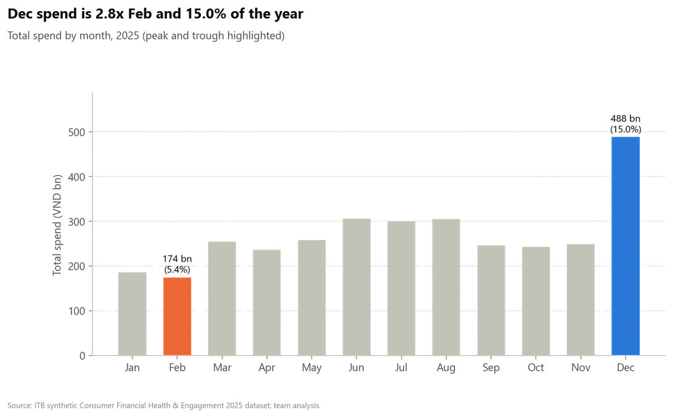
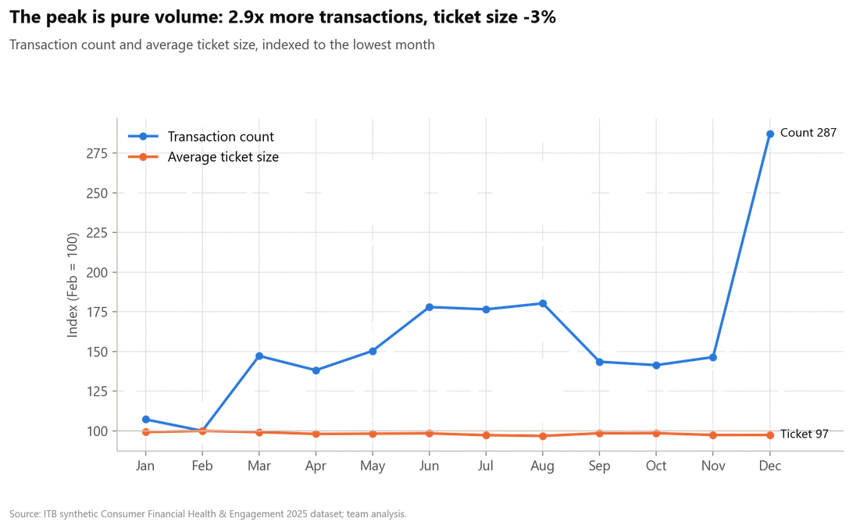
Overview
Busy months mean more purchases, not a higher AOV (Task 1, Q1)
DECEMBER PEAK: Spending hits its yearly high, 2.8x the lowest month
WHAT DRIVES IT: More transactions, not bigger baskets
Figure 1. Total spend by month, 2025
Figure 2. Transaction count and average ticket size, indexed to February = 100
  December reaches VND 488 bn (15% of the year) vs 174 bn in February, a gap of VND 314 bn
  Spend-to-income jumps to 1.25 in December, vs 0.45–0.79 in other months: customers spend more than they earn
  Transactions rise 2.9x, while the average ticket shrinks 2.6%, so volume explains the whole gap
  Same customers (918 vs 919), each buying 306 vs 106 times; all 14 categories double, and the spending mix stays unchanged
December is the peak spending month because customers buy almost three times as often, not because they buy bigger: each transaction is even 2.6% smaller than in February. These frequent, ordinary purchases add up to overspending in this month.
Project Overview
Exploratory Analysis
Detailed Analysis
Modelling
Recommendation

Slide 5
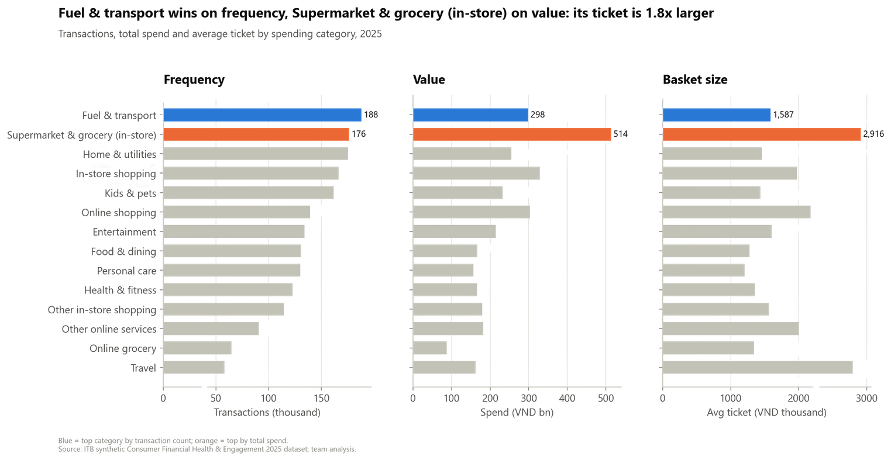
Overview
Fuel gets swiped most often, but groceries take the biggest share of wallet (Task 1, Q4)
  By transaction count: Fuel & transport, 188,029 transactions (10.2%), average ticket VND 1,586,933.
  By spend: Supermarket & grocery (in-store), VND 513.8 bn (15.8%), average ticket VND 2,916,003, which is 1.84x larger.
  Visit frequency is almost the same (17.1 vs 16.0 transactions per customer-month), and both are POS-heavy (69.8% and 75.1% POS).
Figure 3. Transactions, spend and average ticket by category
Fuel is a small, repeated top-up; groceries are a basket nearly twice as large. Frequency builds engagement, basket size builds value.
Project Overview
Exploratory Analysis
Detailed Analysis
Modelling
Recommendation

Slide 6
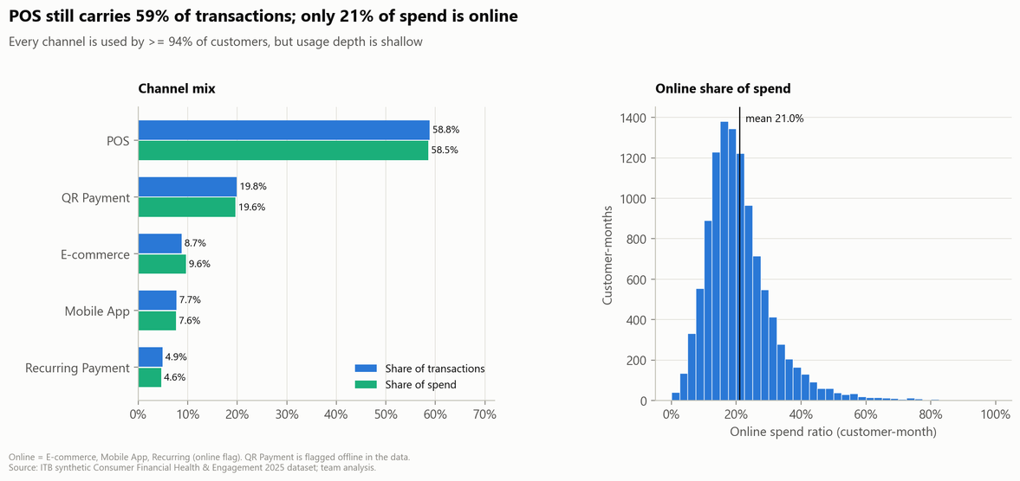
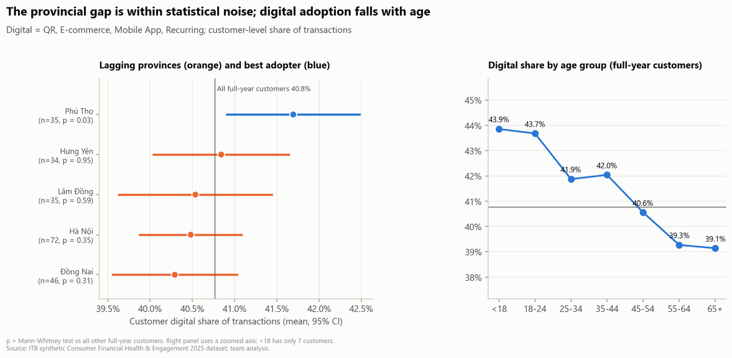
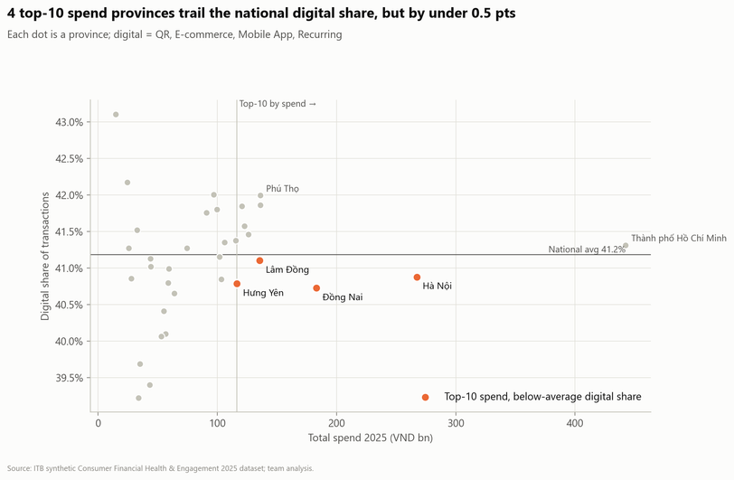
Overview
Customers use every channel, and where they live matters less than their age (Task 3, Q2 -Task 1, Q3)
CHANNELS: Everyone tries every channel, but online use stays shallow
GEOGRAPHY VS AGE: The digital gap is generational, not regional
Figure 4. Channel mix and distribution of online spend ratio
Figure 6. Lagging provinces with 95% confidence intervals and digital share by age group
  925 of 999 customers use all five channels, yet POS still carries 59% of transactions
  Only 21% of spend is online (41% including QR); Recurring Payment is just 4.9%, the channel with the most headroom
  Four top-10 provinces trail the national share by only 0.1–0.5 pts, and none is significant (p ≥ 0.31). Closing the gap would shift only about 1,300 transactions a year
  Digital share falls steadily with age, from 43.9% to 39.1% (rho −0.52, p < 0.001)
Adoption is broad but shallow: the issue is depth, not reach. The digital gap is generational, not regional, and no lagging province differs significantly from the rest.
Four high - spend provinces sit just below the national line
Figure 5. Province spend versus digital share of transactions
Project Overview
Exploratory Analysis
Detailed Analysis
Modelling
Recommendation

Slide 7
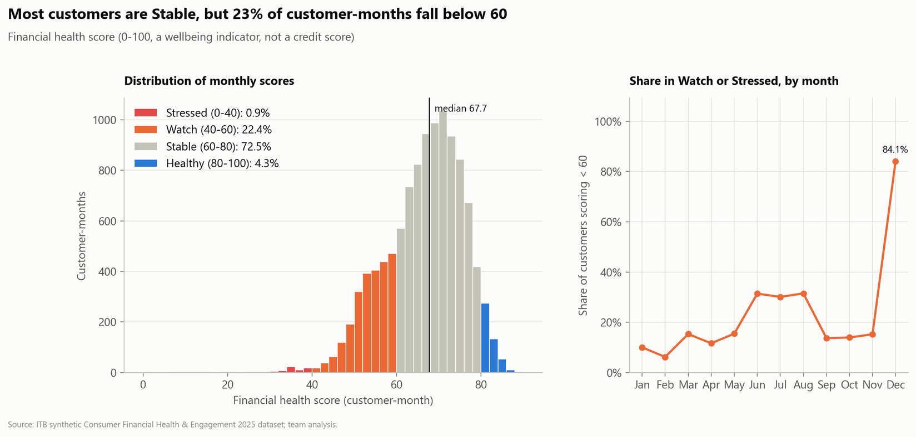
Financial Health Analysis
Most customers have tough months, and they come with the spending peaks (Task 2, Q1)
  There is a long tail of bad months. 22.4% of months fall to Watch (40–60), which pulls the average down.
  Almost everyone has a tough month. 87% of customers have at least one (according to calculation)
  December is the worst month (84% of customers in a tough month). February is the best
Figure 7. Distribution of monthly health scores and share below 60 by month
Almost every customer goes through a tough month, and financial difficulty is closely tied to spending: in the peak month, December, 84% of customers fall below 60.
Project Overview
Exploratory Analysis
Detailed Analysis
Modelling
Recommendation

Slide 8
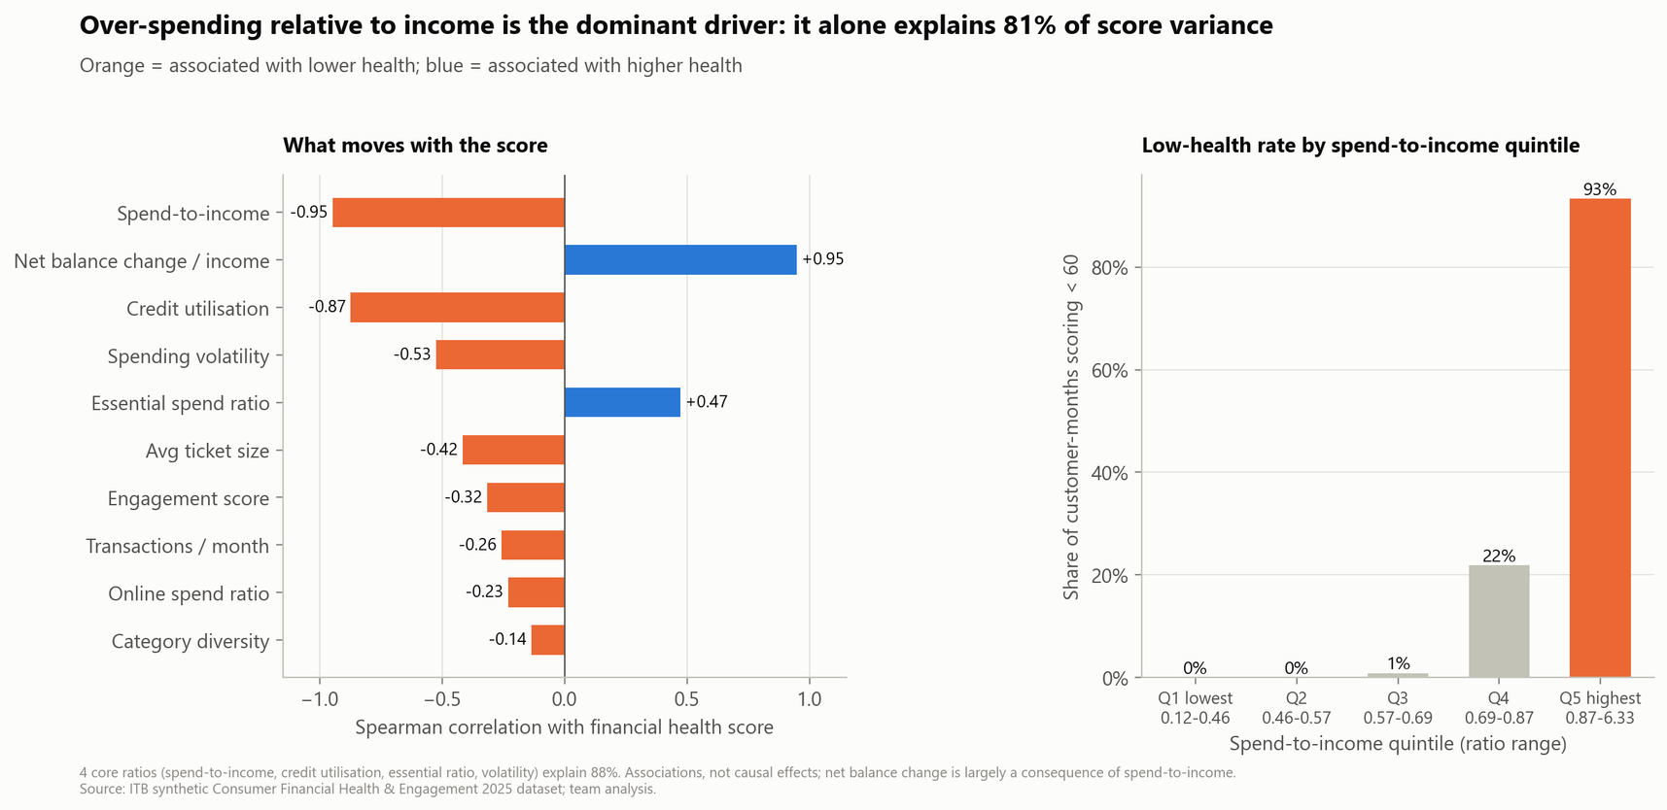
Financial Health Analysis
Tough months are months when customers spend more than they earn (Task 2, Q2)
  One factor dominates. Spend-to-income alone explains 81% of the health score (rho -0.95).
  Credit utilisation (rho -0.87) moves with it (correlation 0.90), so both reflect the same over-spending pressure.
  Risk jumps past a threshold: tough months are almost absent below ~70% of income but reach 93% above 87%.
Figure 8. Correlates of the health score and low-health rate by spend-to-income quintile
Low financial health comes mainly from spending too close to income. The more customers spend relative to what they earn, the lower their score tends to be, far more than with any other factor. Irregular spending and a smaller share on essentials add little once this is known.
Project Overview
Exploratory Analysis
Detailed Analysis
Modelling
Recommendation

Slide 9
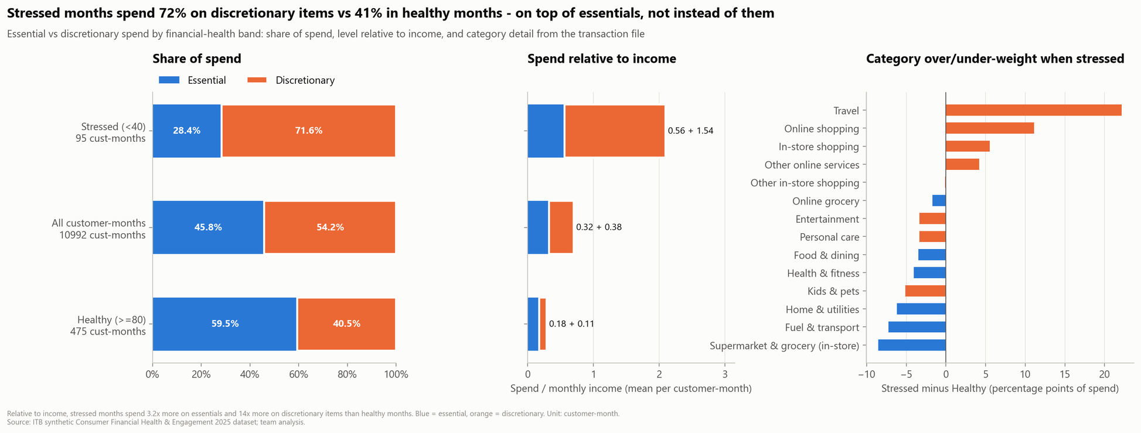
Financial Health Analysis
In stressed months, discretionary spending takes over the budget and pushes it far past (Task 1, Q2)
  Discretionary dominates stressed months: 72% of spend vs 41% in healthy months.
  Travel leads the shift (+22.2 pts), then online shopping (+11 pts).
Figure 9. Essential versus discretionary spend by health band: share, level relative to income and category detail
  Discretionary explodes: 1.54x income vs 0.11x, pushing total spend to about 2.1x income.
Stressed months are driven by discretionary spending, mainly travel and shopping, not by essentials.
Project Overview
Exploratory Analysis
Detailed Analysis
Modelling
Recommendation

Slide 10
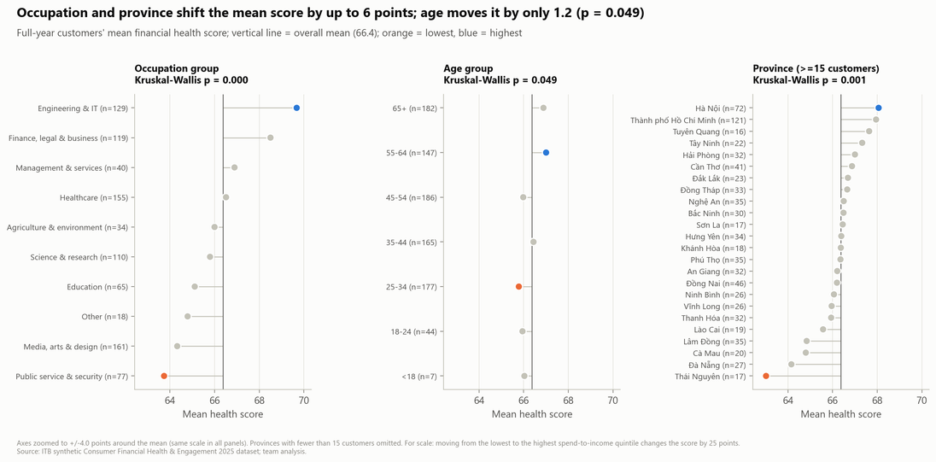
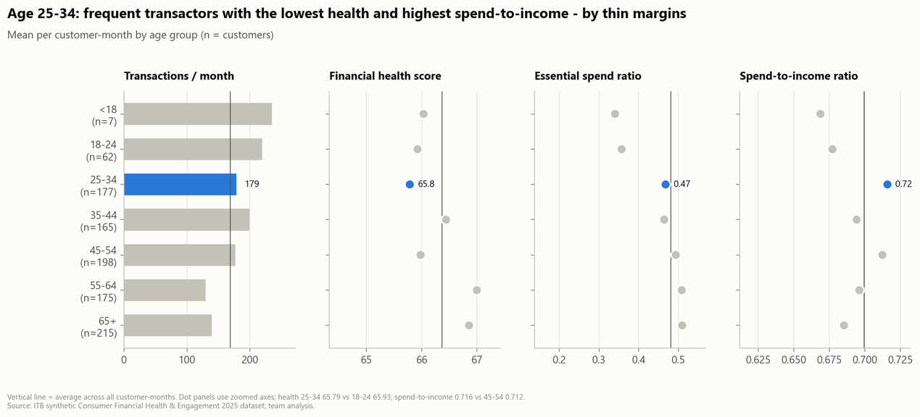
Financial Health Analysis
It's how people spend, not who they are, and that shapes financial health (Task 2,Q3; Task 1, Q5)
DEMOGRAPHICS: Job and location matter a little, and only through spending
AGE: Young workers spend the most relative to income, but the gap is small
Figure 10. Mean health score by occupation, age group and province (full-year customers)
Figure 11. Frequency, health, essential ratio and spend-to-income by age group
  Occupation and province shift health by only 5–6 pts (Engineering & IT 69.7 vs Public service 63.7; Hà Nội 68.1 vs Thái Nguyên 63.0), and both gaps track spend-to-income (rho −1.00 and −0.92)
  Spend-to-income alone moves the score by about 25 pts across its quintiles, roughly 4x the largest demographic gap
  Ages 25–34 transact actively (179/month) yet have the lowest health (65.8), with the highest spend-to-income (0.72) and a lower essential share
  Across all ages, health varies by just 1.2 pts (p = 0.049): age is a weak driver
Occupations and provinces with lower health score lower because their customers spend more relative to income, not because of the job or the location itself. Young working adults spend a lot relative to income and lean less towards essentials, but the age gap is small.
Project Overview
Exploratory Analysis
Detailed Analysis
Modelling
Recommendation

Slide 11
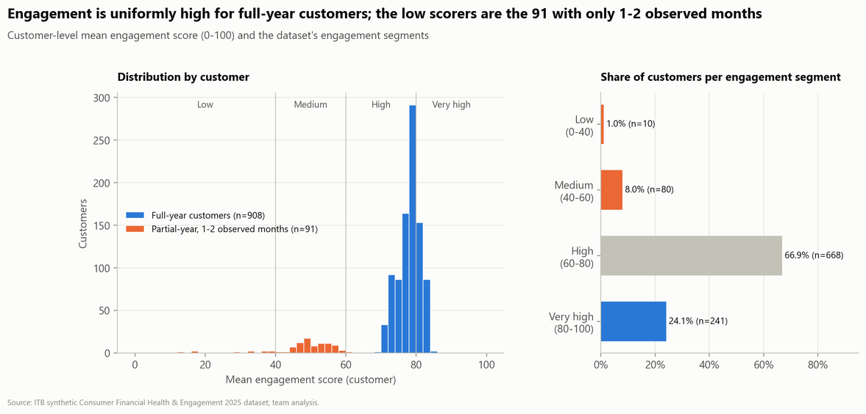
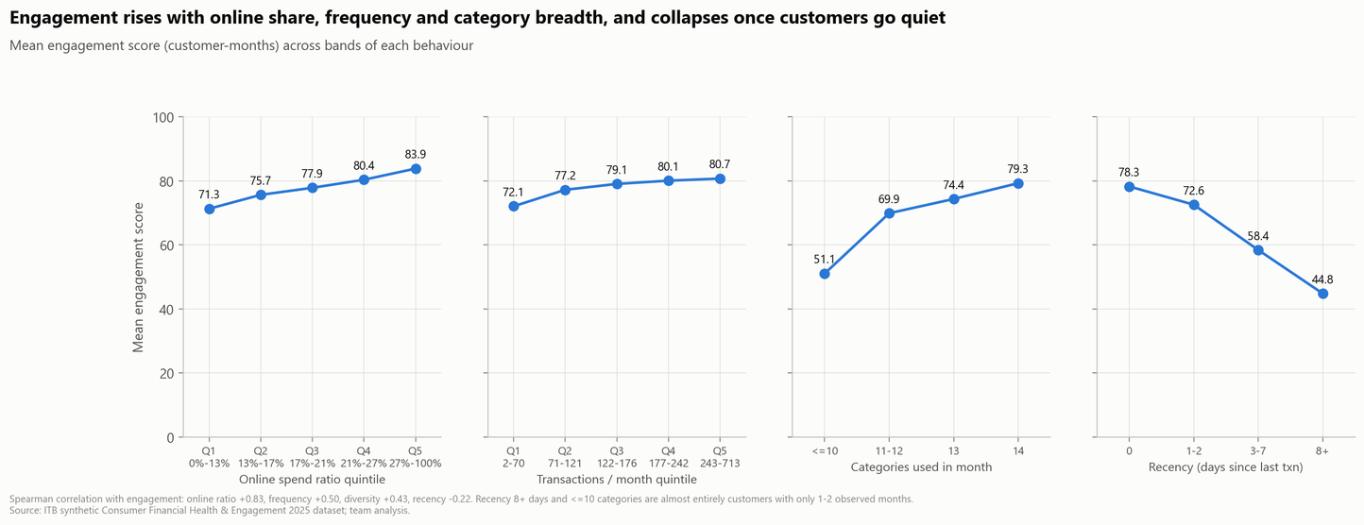
Customer Engagement Analysis
Loyal customers stay engaged, and going digital is what takes them further (Task 3,Q1;Task 3,Q3)
ENGAGEMENT LEVEL: High and even for everyone who stays
WHAT LIFTS IT: Digital depth drives engagement, and it collapses once customers go quiet
Figure 12. Customer-level engagement distribution and segment shares
Figure 13. Mean engagement score across bands of four behaviours
  908 full-year customers average 78.1, all within 70–84; 91% of customers sit in the High or Very high band
  Every Low/Medium scorer has only 1–2 months of data (mean 48.7), a mix of newcomers and leavers rather than proven churn
  Online share is the strongest lever: engagement rises from 71.3 to 83.9 across quintiles (rho +0.83)
  Categories are already saturated (79% use all 14), while engagement falls to 44.8 after 8+ days without a transaction
Engagement among full-year customers is high and even. The engagement challenge is activation of customers with short histories, not retention of established users.
Engagement is at heart a measure of digital depth, the only lever that has not saturated. Recency of 8+ days and 10 or fewer categories are two early-warning signals that can be tracked monthly.
Project Overview
Exploratory Analysis
Detailed Analysis
Modelling
Recommendation

Slide 12
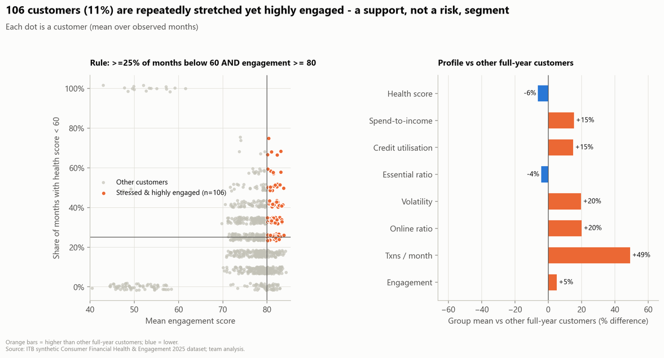
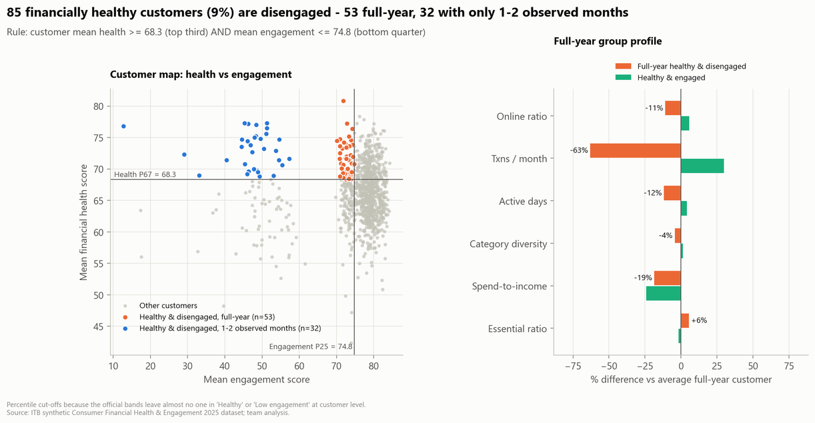
The Tension Between Financial Health and Engagement
Most loyal users are the most stretched, while some of healthiest are drifting away (Task 3,Q5; Task 2,Q4)
LOYAL BUT STRETCHED: Daily users who repeatedly run short
HEALTHY BUT DRIFTING: Good customers who barely use their card
Figure 14. Stressed and highly engaged customers and their profile
Figure 15. Health vs engagement map and profile of healthy but disengaged customers
  106 customers (10.6%) drive 16.5% of spend; they make 240 transactions a month (vs 161) at 0.79 spend-to-income (vs 0.69)
  Younger (mean age 39 vs 51); their pressure comes from many small online purchases, not big trips
  85 customers (8.5%), of whom 53 are active all year: health 71.5, but 63% fewer transactions and an 11% lower online share
  Older (59% aged 55+): a share-of-wallet problem that matches the age gap in digital use
This group's pressure comes from many small everyday transactions, especially online, unlike the crisis months in section 9 that are driven by large travel expenses.
These are good customers who use their ITB card for only a small part of their spending. This is a share-of-wallet problem, and it matches section 6: digital use falls with age
Project Overview
Exploratory Analysis
Detailed Analysis
Modelling
Recommendation

Slide 13
Data preprocessing
Turning monthly records into clean, comparable behavioural features for segmentation (Task 4, Q1)
Aggregate
Population split
Quality check
Feature engineer
Transform
  Customer-months → 1 row per customer
  Mean of monthly ratios
  Total spend kept for profiling
  908 full-year customers
→ modelled
  91 with 1–2 months
→ rule-based New / Low-history
  No imputation needed
  Full transaction file verified
  Near-duplicate feature dropped
  Financial features
  Engagement features
  Validation features
  Composite indices
  Winsorize p99
  Log1p
  Z-score scaling
  PCA per block
Model features | Model features
spend_to_income | Monthly spend/income; above 1 means overspending
credit_utilization | Balance / credit limit; reliance on credit
essential_ratio | Share of spend on essentials; spending discipline
spending_volatility | How erratic monthly spending is
txn_count | Transactions per month; usage frequency
active_days | Days with at least one transaction; regularity
online_ratio (log) | Share of spend made online; digital adoption
recency (log) | Days since last transaction; signs of going quiet
Feature selection & PCA
Redundancy
check
Pairwise correlation between candidate features
|r| > 0.95 → drop (balance trend vs spend-to-income, r = −0.998)
Block PCA
PCA on standardised features within each block
Eigenvalue > 1 (Kaiser): Financial 2 PCs, Engagement 2 PCs
Block weighting
Standardise PCs, divide by √(number of PCs)
Each block contributes equal variance
Candidate test
Transaction-rhythm block (weekend, night, hour)
Not adopted: hours are fixed by category in synthetic data
  Not used as model inputs: financial_health_score, engagement_score
→ Kept as independent benchmarks: our Health Index matches the given score at r = 0.89, and the Engagement Index at r = 0.94
  Demographics: used for description only, never for clustering
  Validation features: share of months below 60, next-month crisis rate
Project Overview
Exploratory Analysis
Detailed Analysis
Modelling
Recommendation

Slide 14
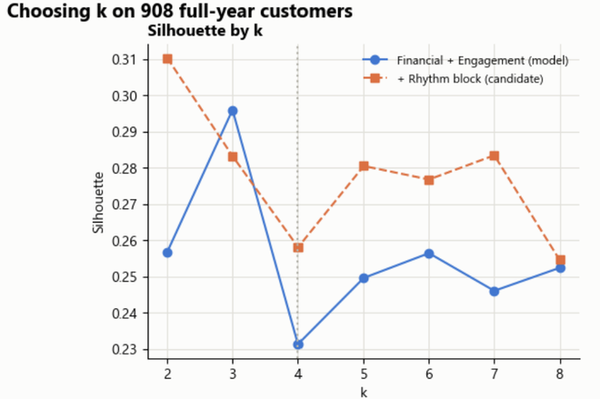
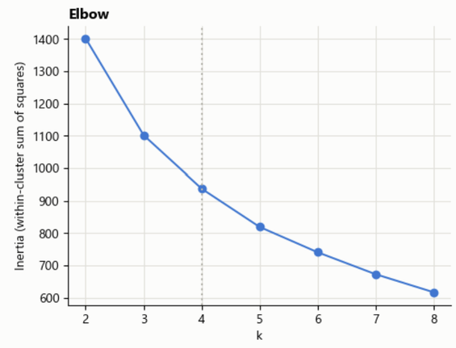
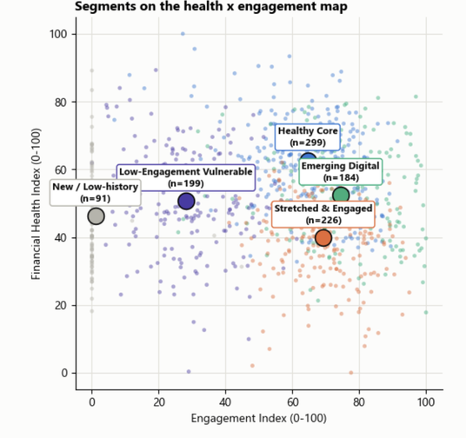
Customer Segmentation
Using K-Means algorithm to group customers into 5 segments (4 K-Means clusters + 1 rule-based group)
12- month data (908 customers)
→ Feature Engineering → Clustering
Model Chosen
K-means Clustering with Optimal K
999 customers
Only 1–2 month data (91 customers) → Rule-based
Metrics
Silhouette score, Inertia (Elbow)
Input variables
Determining the number of clusters (K=4)
K-means clustering
Financial Health:
  Spend_to_Income
  Credit_Utilization
  Essential_Ratio
  Spending_Volatility
Engagement:
  Txn_Count
  Active_Days
  Online_Ratio
  Recency
Standardization
Z-score scaling
Project Overview
Exploratory Analysis
Detailed Analysis
Modelling
Recommendation

Slide 15
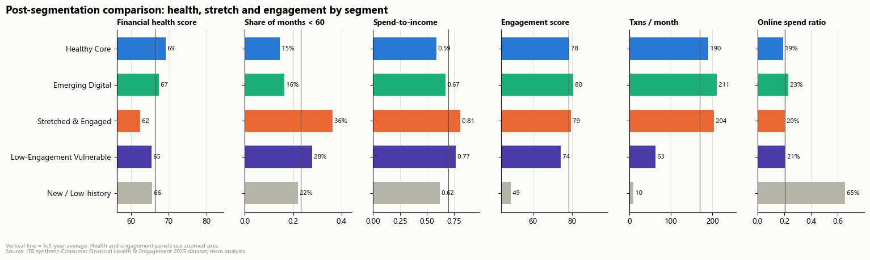
Customer Segmentation
Identify the characteristics of each cluster and propose tailored strategies accordingly (Task 4, Q2)
Characteristics of Each Segment
Cluster 0:
New / Low-history
Their apparent low activity reflects just 1–2 observed months. They are best treated as customers whose habits are still unknown, rather than labelled inactive or low value.
These customers spend well within their means (59% of income) and account for nearly a third of recorded spending. They appear to be a financially stable customer base with room to save or plan for longer term goals.
Cluster 1 :
Financially Healthy Core
Cluster 2 :
Emerging Digital Customers
Mostly aged 25–44, they make the most transactions (211/month) and contribute 31.9% of spending. A relatively small group is already generating substantial activity and value through digital channels.
Cluster 3 :
Stretched but Highly Engaged
They transact frequently (204/month), but spending consumes 81% of income and their financial health is the weakest. Their activity makes financial strain visible early and creates an opportunity for timely budgeting support.
Cluster 4 :
Low Engagement Financially Vulnerable
With only 63 transactions/month and below-average financial health, they show both limited activity and financial pressure. They may be harder to reach through transaction-based messages, so support should be simple and easy to access.
Project Overview
Exploratory Analysis
Detailed Analysis
Modelling
Recommendation

Slide 16

Customer Segmentation
Limitation & Next Steps (Task 4, Q3)
Limitation
Future work
#1
Static averages: each customer is one 12-month mean vector, so seasonality (e.g. the December spike in Task 1) is averaged away.
#1
Model trajectories (month-to-month migration between segments) instead of yearly averages, and track migration as a KPI.
#2
Continuum, not discrete types: silhouette is modest and HDBSCAN finds no strong density gaps among full-year customers. The four segments are a useful partition of a continuum, not naturally separate populations.
#2
Try soft assignment (GMM) given the continuum, and report membership probabilities for borderline customers.
#3
Add channel-mix and category-mix features from the transaction file as a further candidate block.
#3
Partial-year customers are rule-assigned: 91 customers with only 1-2 months cannot be profiled reliably. Their segment is defined by data length, and they may include both late joiners and early leavers.
Re-segment quarterly, and A/B-test the recommended interventions per segment.
#4
#4
Circularity: the given financial_health_score is very likely built from the same ratios (Task 2: spend-to-income alone explains 81% of it), so agreement between segments and the score partly reflects construction.
#5
Synthetic data: income, limits and balances are synthetic, so only ratios are compared. Hour-of-day features are generation artefacts.
#6
Fairness: age differs strongly by segment (a behavioural consequence, not an input). Any campaign should be checked so that older or younger customers are not systematically excluded from beneficial offers.
Project Overview
Exploratory Analysis
Detailed Analysis
Modelling
Recommendation

Slide 17
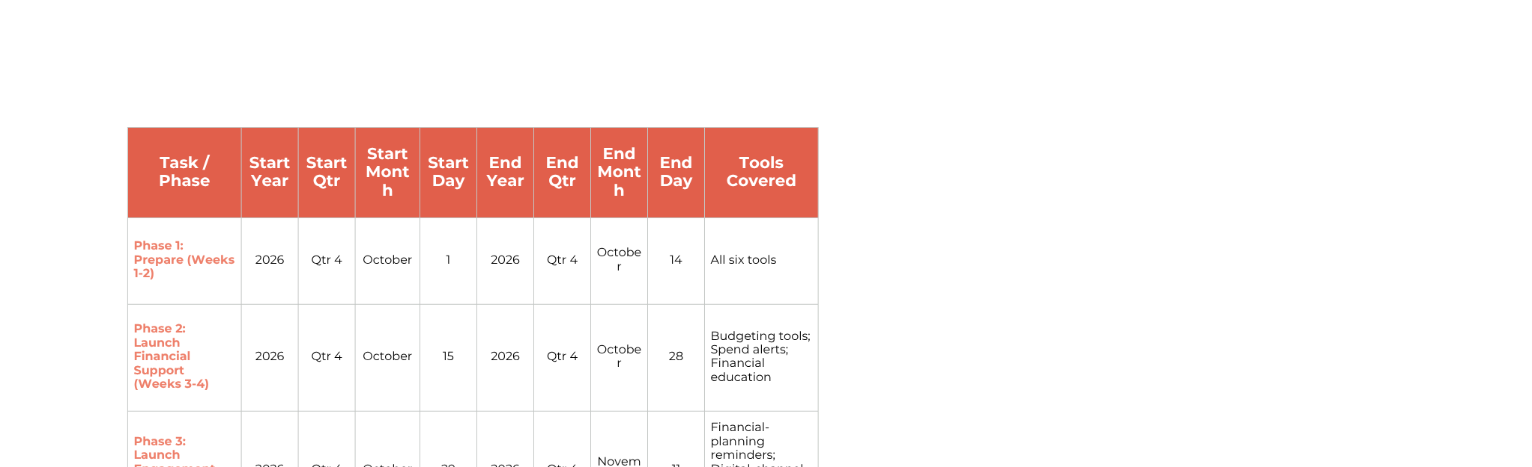
Recommendation
Six non-punitive interventions
Visual Timelines and Roadmaps
Immediate Actions Timeline
  Weeks 1–2 (Preparation):
    Refresh health & engagement data; set baseline KPIs.
    Define targeting filters (Health < 60, risk thresholds) & opt-out rules.
  Weeks 3–4 (Financial Support Launch):
    Deploy Budgeting Tools to cap non-essential spend for Health < 60.
    Launch Real-time Alerts triggered by Spend/Income > 0.80 or Credit Util > 0.70.
    Roll out Financial Education micro-modules for vulnerable cohorts.
Long-Term Strategies Roadmap
  Weeks 5–6 (Engagement Support Launch):
    Send automated Planning Reminders ahead of due dates.
    Push Digital Nudges to transition high-spend users to app/QR channels.
    Offer Suitable Product Suggestions (auto-save, 0% installments).
  Weeks 7–10 (Monitor & Evaluate):
    Track adoption rates, health recovery, and alert fatigue.
    Decide to scale, refine, or pause interventions based on net user benefit.
Future Analysis Plan
  Next 6 Months (Predictive Risk & CLV):
    Build early-warning models to predict financial distress before health score drops.
    Measure Customer Lifetime Value (CLV) impact on supported crossover cohorts.
  Next 12 Months (Advanced Segmentation):
    Implement ML-driven segmentation using transaction velocity and merchant mix.
    Dynamically refine recommendation algorithms based on real-time health trajectories.
Project Overview
Exploratory Analysis
Detailed Analysis
Modelling
Recommendation

Slide 18
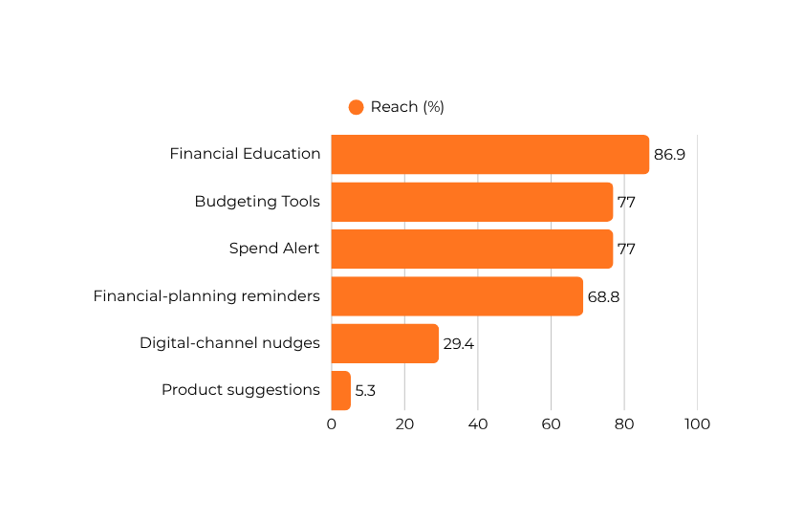
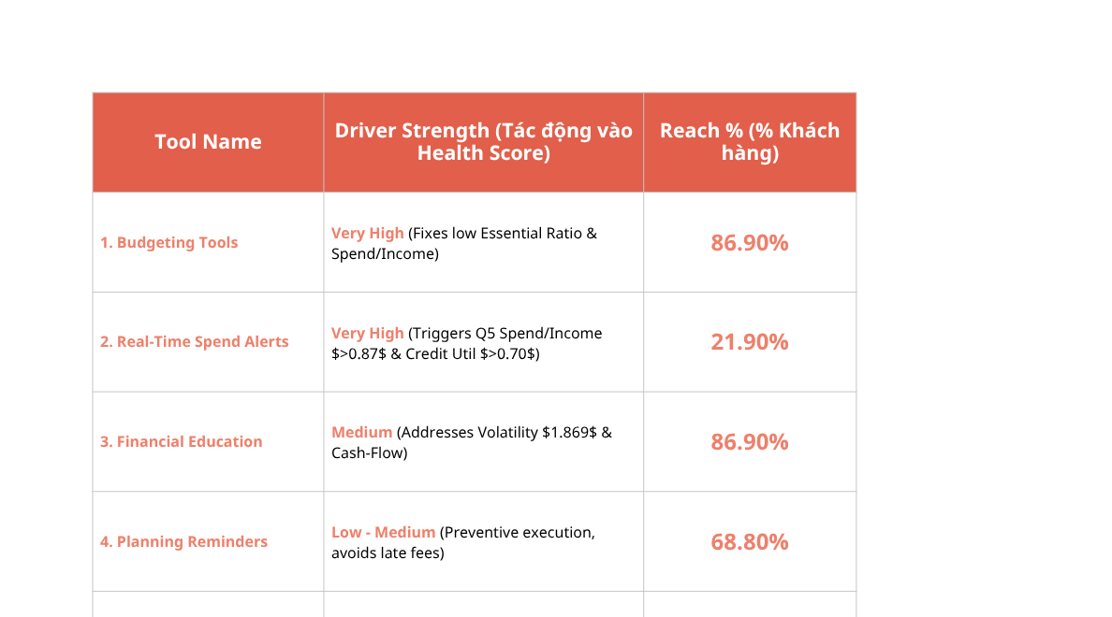
Recommendation
Six non-punitive interventions
Ranking by reach and by drivers’ strength
Low Impact
High Impact
High Reach
Financial Education
Planning Reminders
Budgeting Tools
Low Reach
Digital Nudges
Suitable Products
Spend Alerts
Project Overview
Exploratory Analysis
Detailed Analysis
Modelling
Recommendation

Slide 19
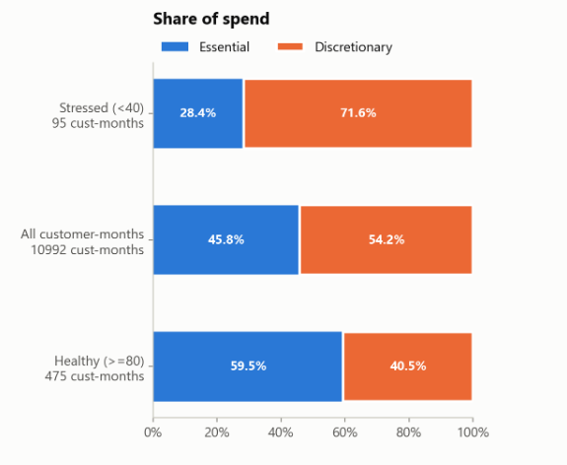
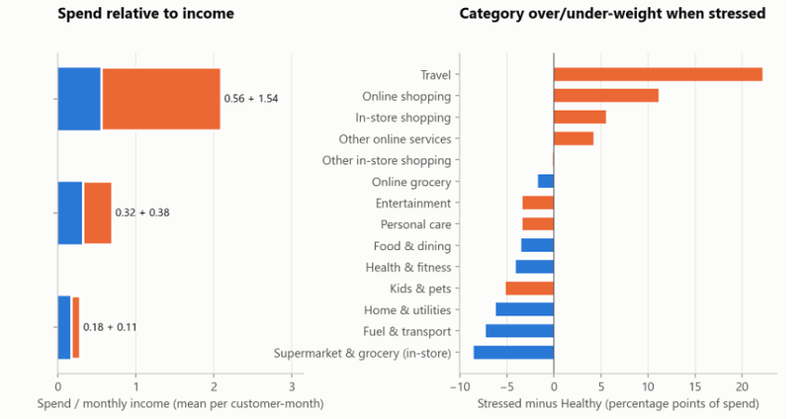
Recommendation
Six non-punitive interventions
Budgeting tools
Customers in the Health < 40 band show a severe imbalance in their spending structure: Non-essential spending accounts for a significantly higher proportion of total expenditure compared to essential needs, driving up the Spend-to-Income ratio.
Finding
Provide automated Category Budgeting with a focus on Capping Discretionary/Non-essential Spending (e.g., setting a 30% threshold of monthly income for non-essential items using a standard 50/30/20 framework).
Action
Target Group
Customers whose spending exceeded income at least once in the past three months.
707 customers (77.0% of December customers), prioritizing the 687 who spent more than their income in December.
Reach
Financial education
Finding
86.9% of unique customers (869/1,000) experience at least one vulnerable month (Health < 60).
Deliver In-App Micro-Learning Modules (1–2 minute interactive guides & nudges) focusing on:
  Managing discretionary vs. essential cash flows.
  Building emergency savings buffers to cushion volatility.
  Smart credit card usage (avoiding high credit utilization penalties).
Action
Target Group
Customers experiencing financial health stress (Financial Health < 60).
869 customers (86.9%) (All unique customers who recorded at least one month in the vulnerable zone).
Reach
Project Overview
Exploratory Analysis
Detailed Analysis
Modelling
Recommendation

Slide 20
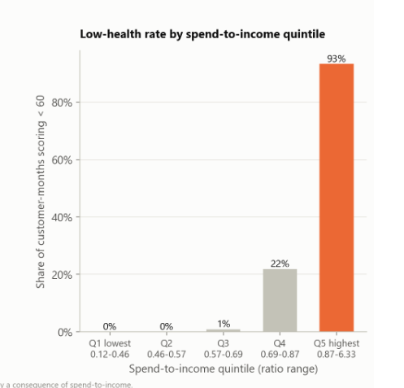
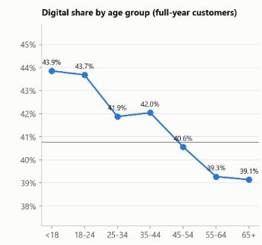
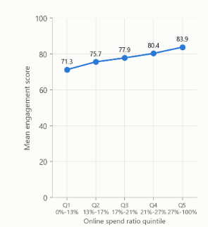
Recommendation
Six non-punitive interventions
Spending
Alerts
Finding
Customers in the Health < 40 band show a severe imbalance in their spending structure: Non-essential spending accounts for a significantly higher proportion of total expenditure compared to essential needs, driving up the Spend-to-Income ratio.
707 customers (77.0% of December customers), prioritizing the 687 who spent more than their income in December.
Reach
Action
Provide automated Category Budgeting with a focus on Capping Discretionary/Non-essential Spending (e.g., setting a 30% threshold of monthly income for non-essential items using a standard 50/30/20 framework).
Target Group
Customers whose spending exceeded income at least once in the past three months.
Digital-channel nudges
Among full-year customers, digital transaction share falls from 43.7% for ages 18–24 to 39.1% for ages 65+. Engagement rises from 71.3 to 83.9 across online-spend-ratio quintiles (|ρ| = 0.83).
Finding
Deepen digital use with assisted QR/app setup and recurring-payment guidance for POS-heavy customers aged 55+. Offer guided onboarding to customers with only 1–2 observed months.
Action
Target Group
Full-year customers aged 55+ with digital transaction share below 40% (203 customers), plus customers in the New/Low-history group (91 customers)
294 customers (29.4% of 999)
Reach
Project Overview
Exploratory Analysis
Detailed Analysis
Modelling
Recommendation

Slide 21
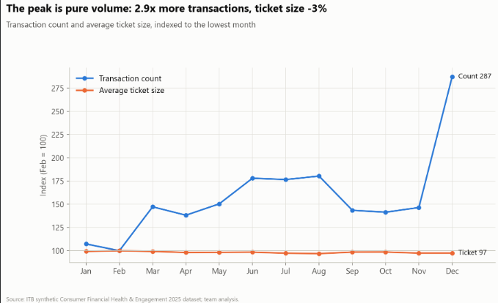
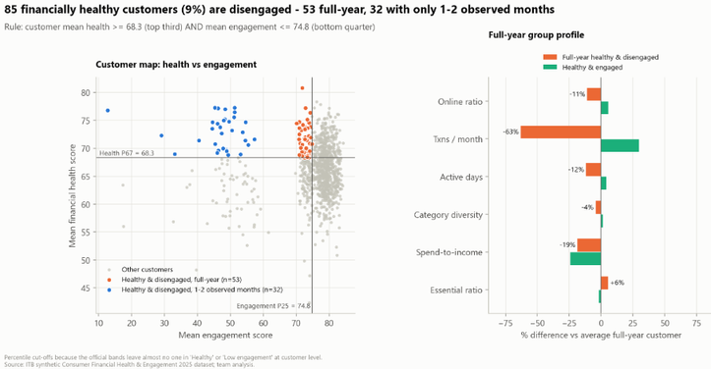
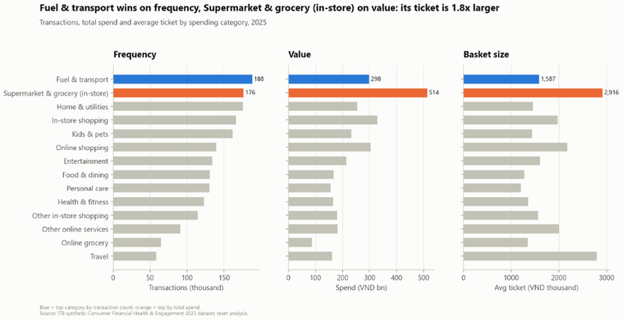
Recommendation
Six non-punitive interventions
Financial-planning reminders
Product suggestions
December spend-to-income reaches 1.25, versus 0.45–0.79 in other months; 84.1% of customers score below 60 in December. December also has 2.9× February’s transaction volume, while average ticket size is 2.6% lower (|ρ| = 0.82).
Finding
Finding
Task 3’s rule identifies 85 customers with mean health score ≥68.3 and mean engagement score ≤74.8. However, 32 have only 1–2 observed months; among the 53 full-year customers, transactions per month are 63% below the full-year average. This indicates an engagement and share-of-wallet opportunity, not credit risk.
Send an October–November reminder to set a year-end budget, then a mid-December check-in showing spend to date and projected month-end spending.
Action
Offer optional savings goals and cashback on everyday categories. Fuel & transport leads transaction frequency (188,029 transactions); supermarket & grocery has the highest spend (VND 513.8bn).
Target Group
Customers whose December spend-to-income ratio is above 1—they spent more than their income that month.
687 customers (68.8% of 999)
Action
Reach
Target Group
For a sustained low-use product offer, target full-year customers meeting Task 3’s rule: mean health score ≥68.3 and mean engagement score ≤74.8.
Reach
53 customers (5.3% of 999)
Project Overview
Exploratory Analysis
Detailed Analysis
Modelling
Recommendation

Slide 22

20
26
Thank You

